Slide 1
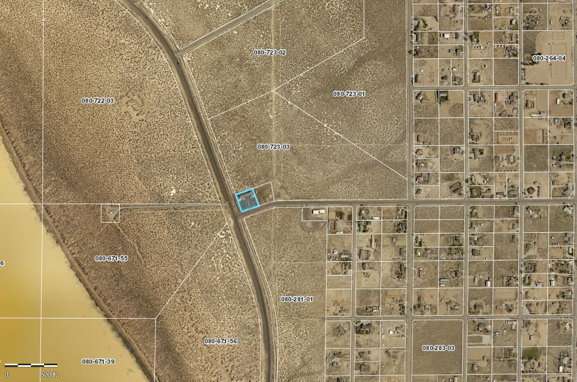
WSUP19-0028
Saving Grace Academy
Washoe County Board of Adjustment
February 6, 2020

Slide 2
Background/Request
The applicant is requesting to establish a Child Daycare use type within a 30 x 52 foot area within the existing New Life Assembly of God
The applicant is requesting to vary the landscaping and parking standards
The parcel has a regulatory zone of Medium Density Suburban, which allows a Child Daycare use type with a Special Use Permit

Slide 3
Project Details
49-child maximum capacity
3 employees at peak shift
Will be housed within the existing New Life Assembly of God building
Hours of Operation 6:30 a.m. - 6:00 p.m.

Slide 4
Vicinity Map

Slide 5
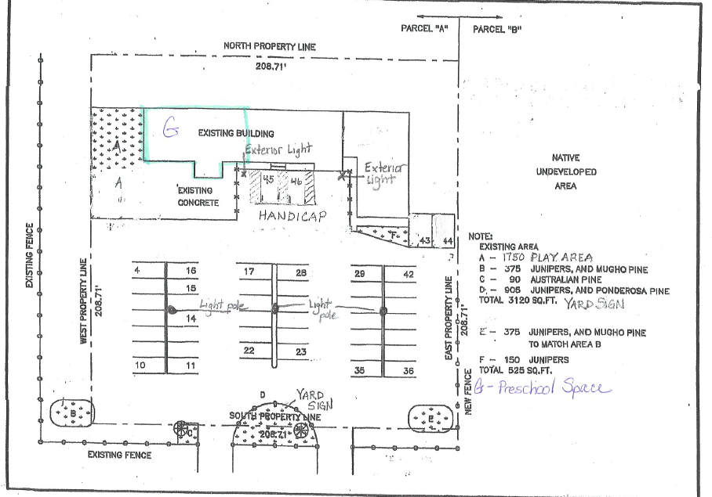
Site

Slide 6
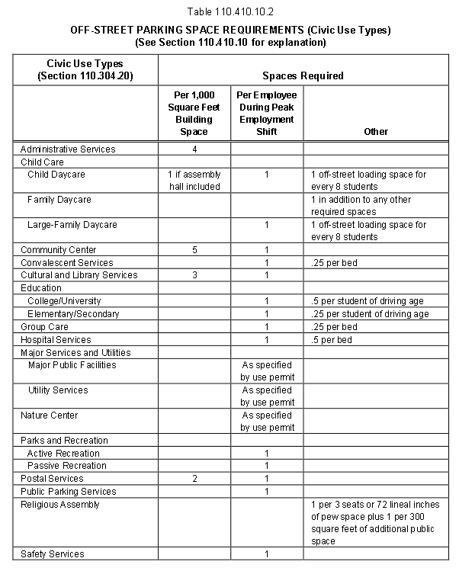
Parking/Traffic
49 total parking spaces available on site.
11 spaces are required, 2 spaces must be handicapped
Applicant anticipates no more than 49 automobiles at one time, which is below the threshold for a traffic report

Slide 7
Varied Standards
Requesting to not bring the site up to current parking and landscaping standards
Per Washoe County Code 110.412.50(e) and interpretation 04-01, the applicant is not required to update a current legal non-conforming development’s parking and landscaping.

Slide 8
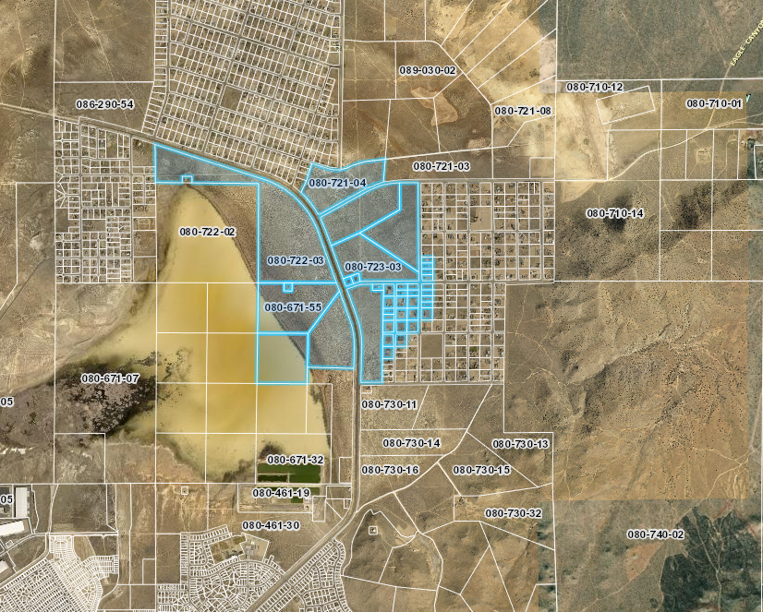
Public Notice & CAB
Notice was sent to 33 affected property owners, 1800 feet from the site.

Slide 9
Citizen Advisory Board
North Valleys CAB on January 13, 2020
  Traffic Impacts on Lemmon Drive
  Adequate existing parking for the proposed use
  Comments on the adequacy of the existing playground
  Citizen support for the daycare
  North Valleys CAB voted unanimously to recommend approving the propose Child Daycare use.

Slide 10
Special Use Permit Findings
Consistency. That the proposed use is consistent with the action programs, policies, standards and maps of the Master Plan and the North Valleys;
Improvements. That adequate utilities, roadway improvements, sanitation, water supply, drainage, and other necessary facilities have been provided, the proposed improvements are properly related to existing and proposed roadways, and an adequate public facilities determination has been made in accordance with Division Seven;
Site Suitability. That the site is physically suitable for child daycare, and for the intensity of such a development;
Issuance Not Detrimental. That issuance of the permit will not be significantly detrimental to the public health, safety or welfare; injurious to the property or improvements of adjacent properties; or detrimental to the character of the surrounding area;
Effect on a Military Installation. Issuance of the permit will not have a detrimental effect on the location, purpose or mission of the military installation.

Slide 11
Recommendation
Those agencies which reviewed the application recommended conditions to address applicable codes and impacts associated with the project. After a thorough analysis and review, staff recommends that the Board of Adjustment carefully consider all aspects of Special Use Permit Case Number WSUP19-0028 and the nature of the stringent recommended conditions of approval and approve the requested Special Use Permit.

Slide 12
Possible Motion
APPROVAL: I move that, after giving reasoned consideration to the information contained in the staff report and information received during the public hearing, the Washoe County Board of Adjustment approve with the conditions included as Exhibit A to the Staff Report, Special Use Permit Case Number WSUP19-0028 for Saving Grace Academy, having made all 5
findings in accordance with Washoe County Code Section 110.810.30.

